Slide 1

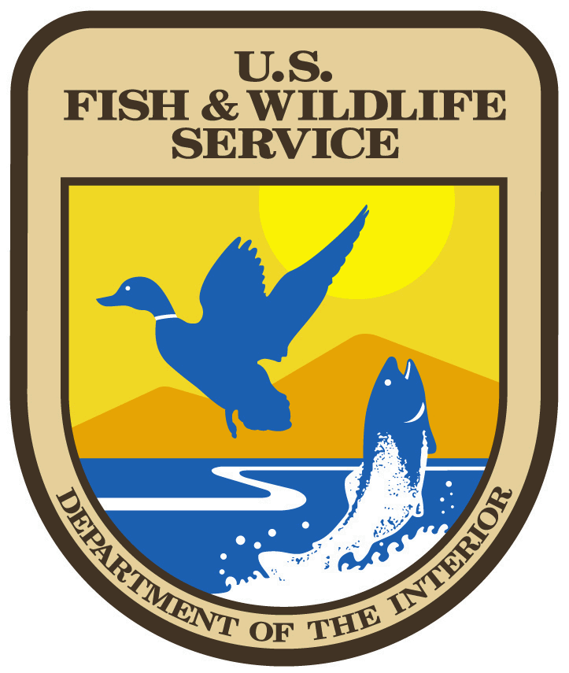
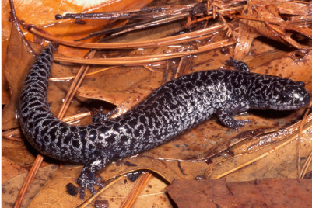
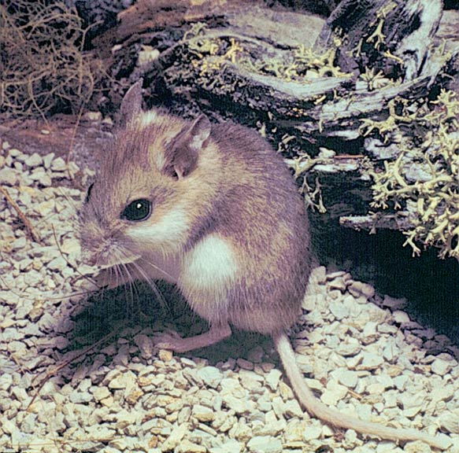
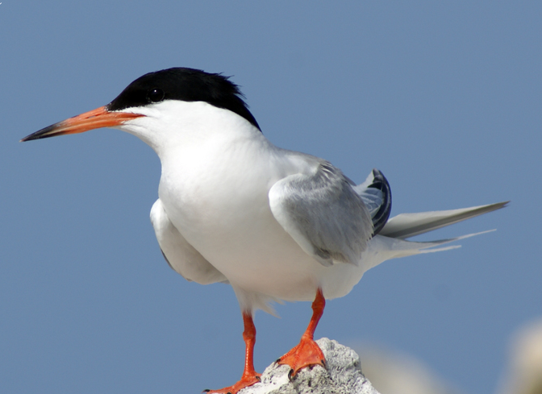
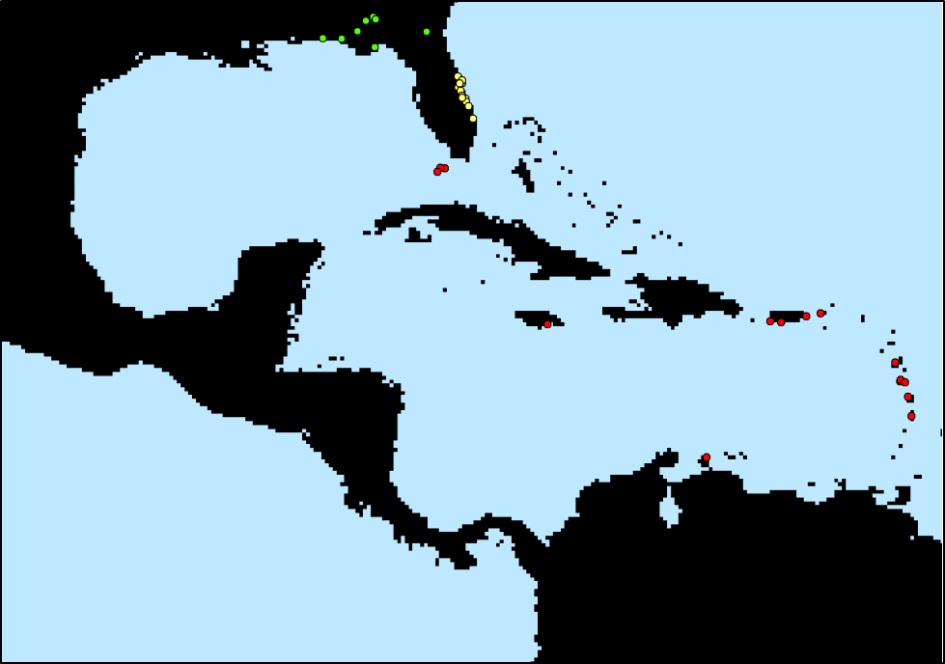
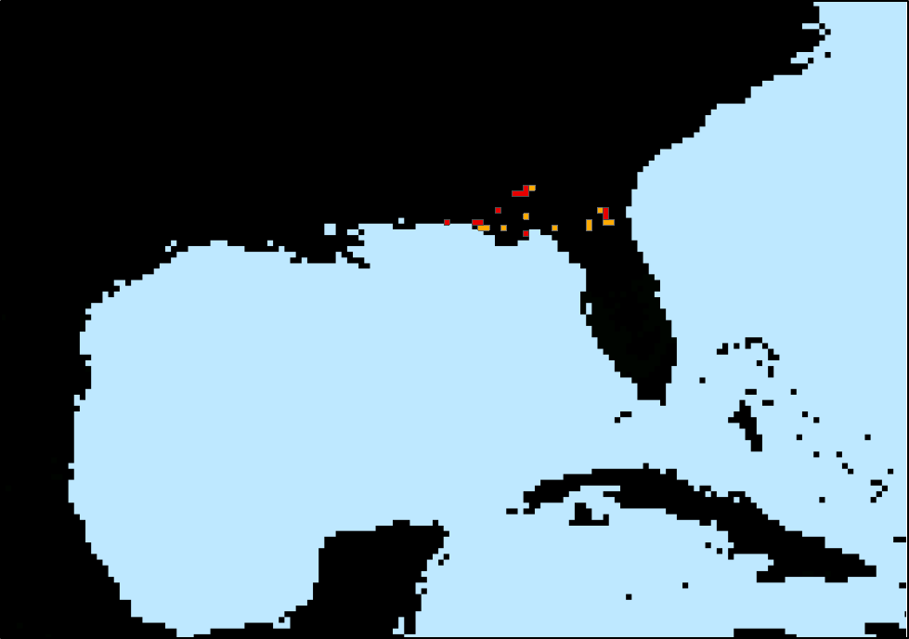
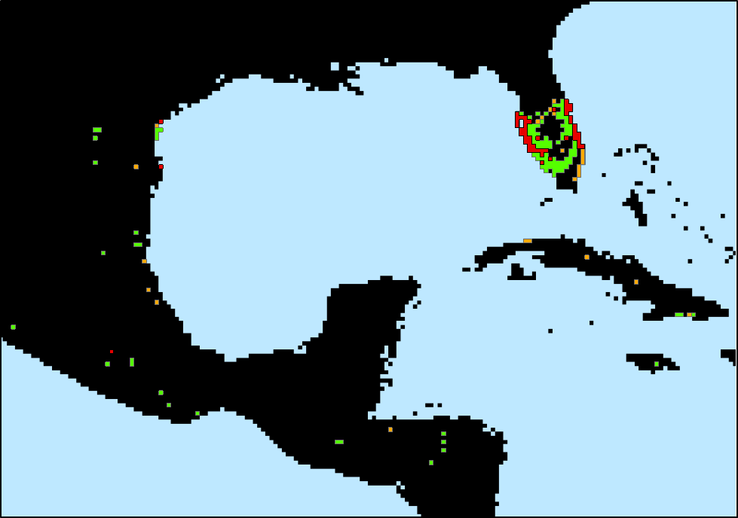
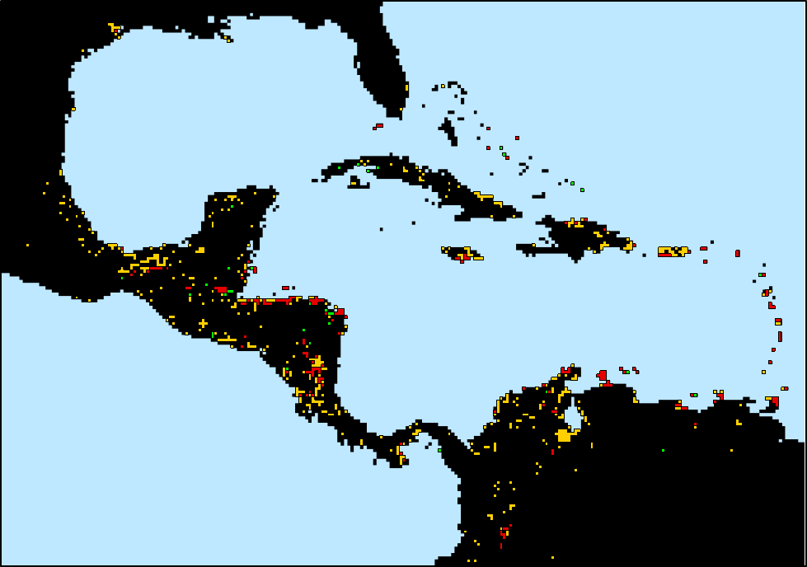
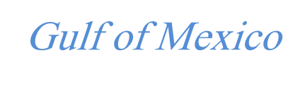
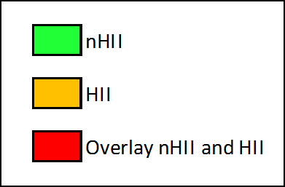
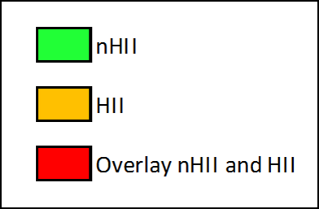
Modeling Effects of Anthropogenic Impact and Climate in the Distribution of Threatened and Endangered Species in Florida
Carolina Speroterra¹, Laura A. Brandt², David N. Bucklin¹, Frank J. Mazzotti¹, Stephanie S. Romañach³, James I. Watling¹
Background
Protection of natural areas from development is a growing concern for many reasons. One of them is that threatened and endangered (T&E) species are commonly regarded as being dependent on these areas and are particularly susceptible to landscape changes. This project uses correlative models to understand how anthropogenic impact and climate affect the geographic range of 16 of Florida’s T&E species.
Data and Tools Used for Model Creation
Results
Categories for SEDAC HII layer
Population Density/sq. km
Proximity to Railroads
Proximity to Major Roads
Proximity to Navigable Rivers
Proximity to Coastlines
Proximity to Nighttime Stable Lights Values
Urban Polygons
Land Cover categories (urban, irrigated agriculture, rain-fed agriculture, forests, tundra and deserts)
Occurrences for 16 Florida T&E terrestrial vertebrate species. (See Table in the Results section)
24 WorldClim contemporary (average between 1950 to 2000) climate variables layers: Monthly mean precipitation and temperature (1 km² resolution)
The Human Impact Index (HII) layer from NASA’s Socioeconomic Data and Application Center (SEDAC). (See Table on the left for details) (1 km² resolution)
High spatial correlation between nHII and HII models (above 0.90 for 14 out of 16 species), indicates high similarity between both models.
Species name | Spatial correlation
Ambystoma cingulatum (AC) | 0.978
Ammodramus maritimus mirabilis (AMM) | 0.995
Ammodramus savannarum floridanus (ASF) | 0.986
Aphelocoma coerulescens (APCO) | 0.994
Charadrius melodus (CM) | 0.902
Crocodylus acutus (CA) | 0.942
Drymarchon corais couperi (DCC) | 0.996
Grus americana (GA) | 0.944
Mycteria americana (MA) | 0.979
Neoseps reynoldsi (NR) | 0.995
Peromyscus polionotus niveiventris (PPN) | 0.744
Picoides borealis (PB) | 0.980
Polyborus plancus audubonii (PPA) | 0.993
Puma concolor coryi (PCC) | 0.993
Rosthramus sociabilis plumbeus (RSP) | 0.984
Sterna dougallii dougallii (SDD) | 0.717
Kappa analysis (number of species’ presences and absences correctly classified in the models) shows almost no change for a vast majority of the species (13 out of 16)(see histogram below).
Ambystoma cingulatum (AC), Peromyscus polionotus niveiventris (PPN), and Sterna dougallii dougallii (SDD) had a significant increase in kappa (above 0.05) after the inclusion of the HII layer. A common factor among these species is that they have a coastal distribution, few recorded occurrences, and the kappa obtained with the climate only layers were below 0.5.
R software and its Random Forests (RF) library.
Biomapper software used for selecting relevant climate variables according to the distribution of each species.
Ambystoma cingulatum
Peromyscus polionotus
niveiventris
Sterna dougallii dougallii
N
N
N
N
Methods
Gulf of Mexico
Gulf of Mexico
Credit Michael Reidmer
Credit Friends of the Archie Carr NWR
Credit Gabriel Lugo
Grid size of the climate and HII layers were resampled from 1 km² to 325 km², to match already-developed climate-only models from a previous project.
A prediction area suited for each species was established with a ‘target mask’ based on the ranges of phylogenetically similar species.
Models were trained with 75% of the occurrence data and tested with 25% of the data. Random pseudo-absences were created in order to run the RF algorithm.
Probability maps were converted to binary maps (presence/absence) using a threshold calculated through a method that maximizes Cohen’s kappa for each individual species.
Three models per species were used for analysis:
Gulf of Mexico
Occurrences for AC, PPN and SDD
Contemporary distribution predictions for AC
Contemporary distribution predictions for PPN
Contemporary distribution predictions for SDD
Discussion
Climate variables alone might already be suitable predictors of T&E species’ distributions. Inclusion of the Human Impact layer did not significantly affect the distribution predictions for species. This might have been attributed to the following:
Species’ occurrence grids had values that were very prevalent in the overall layer.
  The HII layer values ranged from 0 (pristine) to 64 (max. human impact). The mean value for the state of Florida was 23. Similarly, the mean HII value for all the species’ occurrence grids collectively was 25, ranging from 8 to 37. This range includes almost 45% of the total map area (see figure on the left) and 74% of Florida. Therefore, incorporating the HII layer resulted in medium to low expansion of distribution ranges for a vast majority of species. A clear exception to that trend was the beach mouse (PPN).
Grid size was too coarse.
  This might have been an issue for species with very narrow or patchy habitats. For example, it is known that Neoseps reynoldsi inhabits pristine sand hills and scrubs in the Lake Wales Ridge region which is quite narrow in extent and is surrounded by large human disturbed areas. Due to the coarse grid size used for the models, the skink appears to be occupying heavily impacted areas. In cases like this, our models might not be able to capture the real human impact values of
  the grids occupied.
Significant climate variables only. (nHII models). This set of models were from previous climate models work.
Significant climate variables + HII layer. (HII models)
Significant climate variables + 1 random climate variable (Clim+1 models). This last set of models were created for testing that changes occurring in HII models were due to the nature of the HII layer itself and not just a product of the addition of more information (layers) to the model.
Red areas have HII values within the range on which all of our species occur (8 to 37)
Future models will be created with the same layers but with grids of 1 km² instead of 325 km².
Neoseps Reynoldsi
¹University of Florida, Davie, FL, USA, ²U.S. Fish and Wildlife, Davie, FL, USA, ³U.S. Geological Survey, Southeast Ecological Science Center, Davie, FL, USA. Funding was provided by the U.S. Fish and Wildlife Service, National Park Service Everglades and Dry Tortugas National Park, through the South Florida and Caribbean Cooperative Ecosystem Studies Unit and U.S. Geological Survey (Greater Everglades Priority Ecosystems Science).

